Slide 1


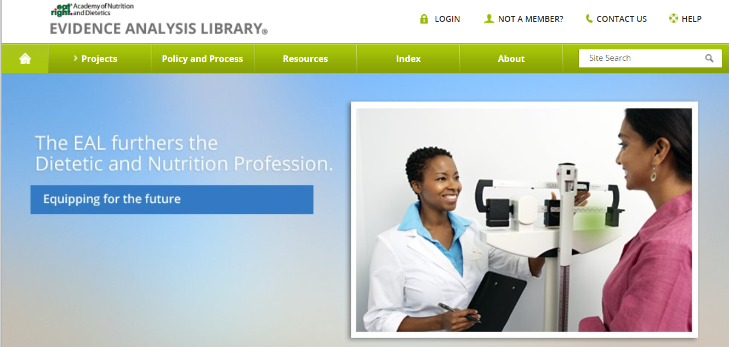
Academy of Nutrition and Dietetics
Evidence Analysis Library®
www.andeal.org
Disorders of Lipid Metabolism: Saturated Fat
Evidence-Based Nutrition Practice Guidelines
Executive Summary of Recommendations
Guideline published February 2023

Slide 2
Definition
What is Evidence-based Dietetics Practice?
“Evidence-Based Dietetics Practice is the use of systematically reviewed scientific evidence in making food and nutrition practice decisions by integrating best available evidence with professional expertise and client values to improve outcomes.”
A.N.D. Scope of Dietetics Practice Framework: Approved by A.N.D. House of Delegates
© 2023 Evidence Analysis Library®

Slide 3
Overall Guideline Objective
The objective of this guideline is to provide evidence-based recommendations on saturated fat intake to prevent or manage cardiovascular disease.
© 2023 Evidence Analysis Library®

Slide 4
Target Population
Adults (≥18 years of age)
Male and Female
Target Population Description
The scope of the saturated fat systematic review and guideline was not limited by gender or sex, race, ethnicity, anthropometrics, or presence of co-morbidities. This guideline is for individuals living with and without cardiovascular disease, and the scope was not limited to adults with disorders of dyslipidemia. This EBNPG does not apply to children <18 years of age.
© 2023 Evidence Analysis Library®

Slide 5
Guideline Scope Characteristics
Guideline Category
These recommendations focus on the following major outcomes:
Management
Intervention
Counseling
Clinical Specialty
Cardiology, Critical Care, Nutrition, Nursing, Preventive Medicine
© 2023 Evidence Analysis Library®

Slide 6
Statement of Intent
Evidence-based nutrition practice guidelines are developed to help Registered Dietitians, practitioners, patients, families, and consumers make shared decisions about health care choices in specific clinical circumstances. If properly developed, communicated, and implemented, guidelines can improve care.
While the evidence-based nutrition practice guideline represents a statement of promising practice based on the latest available evidence at the time of publication, the guideline is not intended to overrule professional judgment. Rather, it may be viewed as a relative constraint on individual clinician discretion in a particular clinical circumstance. The independent skill and judgment of the health care provider must always dictate treatment decisions. These nutrition practice guidelines are provided with the express understanding that they do not establish or specify particular standards of care, whether legal, medical or other.
© 2023 Evidence Analysis Library®

Slide 7
Disclaimer
While A.N.D. evidence-based nutrition practice guidelines represent a statement of best practice based on the latest available evidence at the time of publishing, they are not intended to overrule professional judgment. Rather, they may be viewed as a relative constraint on individual clinician discretion in a particular clinical circumstance. The independent skill and judgment of the health care provider must always dictate treatment decisions. These nutrition practice guidelines are provided with the express understanding that they do not establish or specify particular standards of care, whether legal, medical or other.
© 2023 Evidence Analysis Library®

Slide 8
Guideline Rating
Each Recommendation is Rated:
  Strong,
  Weak, or
  Consensus
Recommendation statements include terms:
  “Recommend/should” (Strong)
  “Suggest/may” (Weak)
  “It is reasonable” (Consensus)
Each Recommendation Statement is:
  Conditional or
  Imperative
© 2023 Evidence Analysis Library®

Slide 9
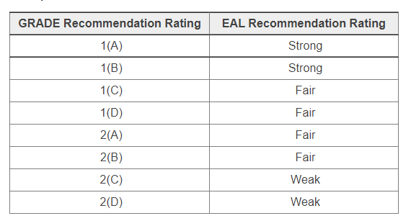
Recommendation Translation
© 2023 Evidence Analysis Library®

Slide 10
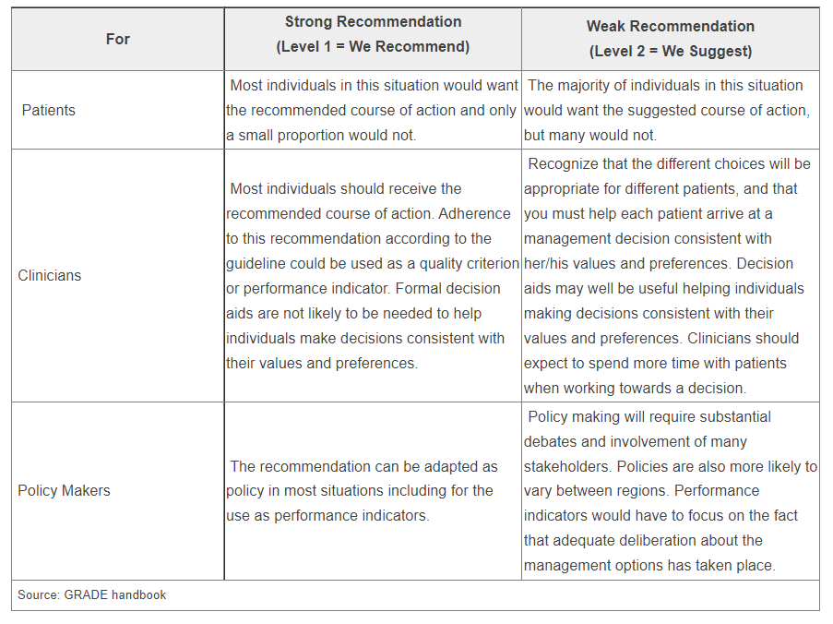
Implications of Strong/Weak Recommendations
© 2023 Evidence Analysis Library®

Slide 11
Conditional/Imperative
Imperative recommendations are broadly applicable to the target population and are stated as “require,” or “must,” or “should achieve certain goals.”
Conditional statements clearly define a specific situation and contain conditional text that would limit their applicability to specified circumstances, or to a sub-population group. More specifically, a conditional recommendation can be stated in if/then terminology.
© 2023 Evidence Analysis Library®

Slide 12

Saturated Fat Topics
Amount of Saturated Fat Intake
Replacement of Saturated Fat Intake
Sources of Saturated Fat Intake
© 2023 Evidence Analysis Library®

Slide 13
Disorders of Lipid Metabolism Saturated Fat
Evidence Based
Nutrition Practice Guideline
Executive Summary of Recommendations
Guideline published February 2023
© 2023 Evidence Analysis Library®

Slide 14
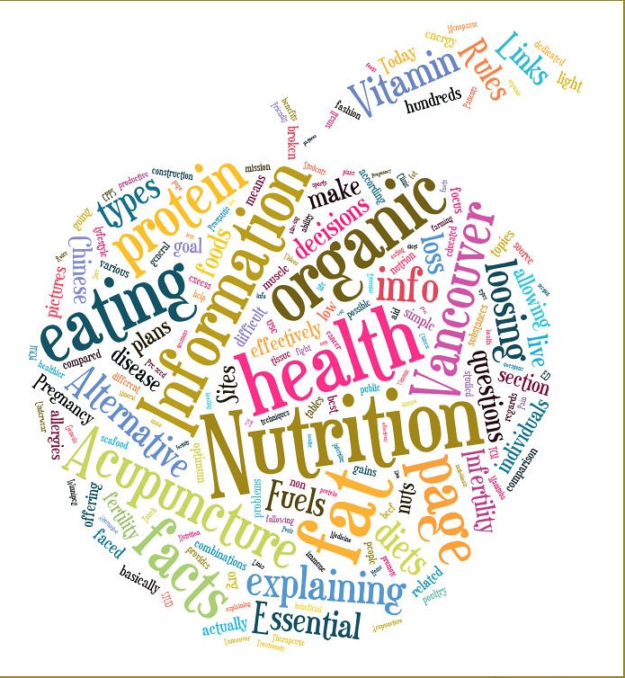
Nutrition Intervention
© 2023 Evidence Analysis Library®

Slide 15
DLMSF: Acronyms & Abbreviations
In alphabetical order
Term | Definition
CHD | Coronary heart disease
CHO | Carbohydrate
CRP | C-Reactive protein
CHD | Coronary heart disease
CV | Cardiovascular
CVD | Cardiovascular disease
EtD Framework | Evidence-to-Decision framework
IL-6 | Interleukin 6
LDL | Low density lipoprotein
HDL | High density lipoprotein
MNT | Medical nutrition therapy
RCT | Randomized controlled trial
RDN | Registered dietitian nutritionist
TFA | Trans-fatty acids
TG | Triglycerides
TNF | Tumor necrosis factor
© 2023 Evidence Analysis Library®

Slide 16
DLM-SF: Amount of Saturated Fat Intake
In adults living with or without cardiovascular disease, healthcare professionals may suggest reduced saturated fat intake within an individualized healthy dietary pattern. Reduced saturated fat intake was associated with decreased total cholesterol and low-density lipoprotein-cholesterol (LDL-C) and cardiovascular disease events; however, no significant associations were found with mortality (all-cause, cardiovascular disease, or coronary heart disease), coronary heart disease events, or cerebral vascular accidents.
Level 2(B)
Imperative
© 2023 Evidence Analysis Library®

Slide 17
DLM-SF: Replacement of Saturated Fat Intake
In adults living with and without cardiovascular disease, healthcare professionals should recommend replacing dietary saturated fat intake with dietary polyunsaturated fat intake. Replacement of dietary saturated fat with polyunsaturated fat promotes healthy eating patterns and reduces total cholesterol and coronary heart disease events; however, there was no significant effect on all-cause, cardiovascular disease, or coronary heart disease mortality.
Level 1(B)
Imperative
© 2023 Evidence Analysis Library®

Slide 18
DLM-SF: Sources of Saturated Fat Intake
Healthcare professionals may prioritize reduction of the amount of saturated fat over reduction of specific sources of saturated fat foods within individualized healthy dietary patterns when providing nutrition education to reduce cardiovascular disease risk. Low certainty of evidence demonstrates that a variety of dairy products are not associated with an increased risk of cardiovascular disease; however, reduction of red meat and processed meat is associated with reduced cardiovascular disease risk.
Level 1(B)
Imperative
© 2023 Evidence Analysis Library®

Slide 19
No Implied Endorsement
No endorsement by the Academy of Nutrition and Dietetics of any brand-name product or service is intended or should be inferred from a Guideline or from any of its components (including Question, Evidence Summary, Conclusion Statement, Conclusion Statement Grade, Recommendation or Recommendation Rating).
  Evidence-based Nutrition Practice Guidelines are intended to serve as a synthesis of the best evidence available to inform registered dietitians as they individualize nutrition care for their clients. Guidelines are provided with the express understanding that they do not establish or specify particular standards of care, whether legal, medical or other.
  Evidence-based Nutrition Practice Guidelines are intended to summarize best available research as a decision tool for A.N.D. members.
© 2023 Evidence Analysis Library®

Slide 20

Guideline Implementation
Information and Resources
© 2023 Evidence Analysis Library®

Slide 21
Resources
The “Considerations for Application” section of each guideline recommendation includes tools and expert advice on implementation.
The following resources provide information to promote the reduction of saturated fat intake within heart-healthy dietary patterns:
  Nutrition Care Manual
  Dietary Guidelines for Americans 2020-2025
  National Lipid Association: Clinician’s Lifestyle Modification Toolbox
  Preventive Cardiovascular Nurses Association
  American Heart Association: Healthy Eating
  Center for Disease Control: 7 Strategies to Live a Heart-Healthy Lifestyle; Prevent Heart Disease
  United States Department of Agriculture (USDA): Heart Health; Fats and Cholesterol – Food and Nutrition Information
© 2023 Evidence Analysis Library®

Slide 22
Guides
To assist nutrition and dietetics professionals with implementing evidence-based practice recommendations and clinical practice innovations into daily practice, the Academy developed Implementing Evidence: From Guidelines to Daily Practice. Download it from: www.andeal.org/guideline-implementation
For tips on implementing the guideline recommendations, download the Saturated Fat Practitioner Guide from the EAL website. This one-page guide is designed with clear and unambiguous language that may help practitioners and their patients/clients to actively participate in shared decision making for their nutrition care. Visit www.andel.org/dlm and select the Dissemination and Implementation tab.
© 2023 Evidence Analysis Library®

Slide 23
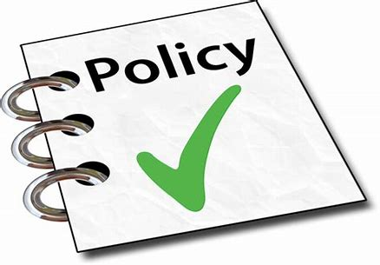
Guideline Development
© 2023 Evidence Analysis Library®

Slide 24
Methods
The methodology for this project was developed using the process of the Academy of Nutrition and Dietetics,^{1,2} in accordance with the Standards for Developing Clinical Practice Guidelines from the National Academy of Science using grading and guideline development tools from the GRADE (Grading of Recommendations Assessment, Development and Evaluation) group.^{3,4}
Visit the EAL for the complete DLM-SF guideline methods.
Handu D, Moloney L, Wolfram T, Ziegler P, Acosta A, Steiber A. Academy of Nutrition and Dietetics Methodology for Conducting Systematic Reviews for the Evidence Analysis Library. J Acad Nutr Diet. 2016;116(2):311-318.
Papoutsakis C, Moloney L, Sinley RC, Acosta A, Handu D, Steiber AL. Academy of Nutrition and Dietetics Methodology for Developing Evidence-Based Nutrition Practice Guidelines. J Acad Nutr Diet. 2017;117(5):794-804.
The GRADE Working Group. GRADE handbook for grading quality of evidence and strength of recommendations. Cochrane Collaboration. https://gdt.gradepro.org/app/handbook/handbook.html. Published 2013. Updated October 2013.
Collaboration TC. Cochrane Handbook for Systematic Reviews of Interventions Version 5.1.0 [updated March 2011]. . In: Higgins JPT GSe, ed.
© 2023 Evidence Analysis Library®

Slide 25
Disorders of Lipid Metabolism: Saturated Fat (2023) Team
Expert Panel Workgroup
Carol F. Kirkpatrick, PhD, MPH, RDN, CLS, Chair
Jo Ann S. Carson, PhD, RDN, LD
Sarah A. Johnson, PhD, RDN
Nicole H. Miller, MPH, RD, CDCES
Ann Fonfa, Patient Advocate
Project Leaders
Deepa Handu, PhD, RDN, Project Manager
Lisa Moloney, MS, RDN, Lead Analyst
Margaret J. Foster, MS, MPH, AHIP, Medical Librarian
Visit the EAL for affiliations and any disclosures of potential conflicts of interests
© 2023 Evidence Analysis Library®

Slide 26

Major Recommendations
This presentation consisted of the Executive Summary of Recommendations for the Academy of Nutrition and Dietetics Disorders of Lipid Metabolism: Saturated Fat Evidence-Based Nutrition Practice Guideline.
The Major Recommendations and more detail (including the evidence analysis supporting these recommendations) is available for free to Academy members and EAL subscribers.
www.andeal.org
© 2023 Evidence Analysis Library®

Slide 27
Learn more:
Academy of Nutrition and Dietetics Evidence Analysis Library®
^{www.andeal.org}
© 2023 Evidence Analysis Library®

