Slide 1
Evidence Analysis Library®
Pre-Hypertension and Hypertension
Systematic Review 2024
Conclusion Statements and Grades
www.andeal.org
Review published February 2024

Slide 2
Academy Definition
“Evidence-Based Dietetics Practice is the use of systematically reviewed scientific evidence in making food and nutrition practice decisions by integrating best available evidence with professional expertise and client values to improve outcomes.”
ADA Scope of Dietetics Practice Framework: Approved by ADA House of Delegates
What is Evidence-based Dietetics Practice?
© 2024 Evidence Analysis Library®

Slide 3
About the Hypertension
Hypertension is the most prevalent risk factor for cardiovascular disease and accounted for nearly 11 million cardiovascular deaths globally in 2021. While approximately 50% of adults in the United States are affected by high blood pressure, it is well-controlled in only 1 of 4 individuals.
Multiple factors increase an individual’s risk for hypertension including genetics, environment, and the interaction of the two. Most environmental risk factors are modifiable and include lifestyle behaviors, including dietary intake. Estimated annual costs attributed to hypertension have been reported to be almost $56 billion US Dollars.
Benjamin EJ, Muntner P, Alonso A, et al. Heart disease and stroke statistics—2019 update: a report from the American Heart Association. Circulation 2019 139(10): e56-e528.
Vaduganathan M, Mensah GA, Turco JV, et al. The Global Burden of Cardiovascular Diseases and Risk: A Compass for Future Health. J Am Coll Cardiol 2022 80(25): 2361-2371.
Whelton PK, Carey RM, Aronow WS, et al. 2017 ACC/AHA/AAPA/ABC/ACPM/AGS/APhA/ASH/ASPC/NMA/PCNA guideline for the prevention, detection, evaluation, and management of high blood pressure in adults: a report of the American College of Cardiology/American Heart Association Task Force on Clinical Practice Guidelines. J Amer Coll Cardiol. 2018 71(19): e127-e248.
© 2024 Evidence Analysis Library®

Slide 4

Systematic Review Objective
Dietary intake and MNT provided by a dietitian have demonstrated efficacy in improving outcomes in adults with pre-hypertension and hypertension. The objective of this systematic review was to examine the research question: In adults with pre-hypertension or hypertension, what is the effect of MNT provided by a dietitian compared to standard care or no intervention on blood pressure, hypertension incidence, medication use, anthropometrics, and cardiovascular risk and events?
© 2024 Evidence Analysis Library®

Slide 5
Explanation of Grades
Grade I – means there is Good/Strong evidence supporting the statement
Grade II – strength of supporting evidence is Fair
Grade III – strength of supporting evidence is Limited/Weak
Grade IV – Expert Opinion only
Grade V – Not Assignable
High (A) – means we are very confident that the true effect lies close to that of the estimate of the effect
Moderate (B) – means we are moderately confident in the effect estimate
Low (C) - means our confidence in the effect estimate is limited
Very Low (D) – means we have very little confidence in the effect estimate
Ungraded – means a grade is not assignable
© 2024 Evidence Analysis Library®

Slide 6

Medical Nutrition Therapy
© 2024 Evidence Analysis Library®

Slide 7
In adults with pre-hypertension or hypertension, what is the effect of medical nutrition therapy (MNT) provided by a dietitian, compared to no intervention or usual care, on arterial stiffness?
Conclusion
In adults with prehypertension or hypertension, medical nutrition therapy provided by a dietitian may reduce arterial stiffness compared to no intervention or usual care.
Grade Low (C)
© 2024 Evidence Analysis Library®

Slide 8
In adults with pre-hypertension or hypertension, what is the effect of medical nutrition therapy (MNT) provided by a dietitian, compared to no intervention or usual care, on blood pressure?
Conclusion
In adults with pre-hypertension or hypertension, medical nutrition therapy provided by a dietitian may decrease systolic and diastolic blood pressure compared to no intervention or usual care.
Grade Low (C)
© 2024 Evidence Analysis Library®

Slide 9
In adults with pre-hypertension or hypertension, what is the effect of medical nutrition therapy (MNT) provided by a dietitian, compared to no intervention or usual care, on body mass index?
Conclusion
In adults with pre-hypertension or hypertension, medical nutrition therapy provided by a dietitian likely reduces body mass index compared to no intervention or usual care.
Grade Moderate (B)
© 2024 Evidence Analysis Library®

Slide 10
In adults with pre-hypertension or hypertension, what is the effect of medical nutrition therapy (MNT) provided by a dietitian, compared to no intervention or usual care, on body weight?
Conclusion
In adults with pre-hypertension or hypertension, medical nutrition therapy provided by a dietitian may reduce body weight compared to no intervention or usual care.
Grade Low (C)
© 2024 Evidence Analysis Library®

Slide 11
In adults with pre-hypertension or hypertension, what is the effect of medical nutrition therapy (MNT) provided by a dietitian, compared to no intervention or usual care, on cardiovascular disease risk score?
Conclusion
In adults with pre-hypertension or hypertension, medical nutrition therapy provided by a dietitian likely reduces cardiovascular disease risk score compared to no intervention or usual care.
Grade Moderate (B)
© 2024 Evidence Analysis Library®

Slide 12
In adults with pre-hypertension or hypertension, what is the effect of medical nutrition therapy (MNT) provided by a dietitian, compared to no intervention or usual care, on change in anti-hypertensive medications?
Conclusion
In adults with pre-hypertension or hypertension, medical nutrition therapy provided by a dietitian likely improves anti-hypertension medication usage compared to no intervention or usual care.
Grade Moderate (B)
© 2024 Evidence Analysis Library®

Slide 13
In adults with pre-hypertension or hypertension, what is the effect of medical nutrition therapy (MNT) provided by a dietitian, compared to no intervention or usual care, on endothelial function?
Conclusion
In adults with pre-hypertension or hypertension, the relationship between medical nutrition therapy provided by a dietitian, compared to no intervention or usual care, is unclear.
Grade Very Low (D)
© 2024 Evidence Analysis Library®

Slide 14
In adults with pre-hypertension or hypertension, what is the effect of medical nutrition therapy (MNT) provided by a dietitian, compared to no intervention or usual care, on mortality?
Conclusion
In adults with pre-hypertension or hypertension, medical nutrition therapy provided by a dietitian may not affect total or cardiovascular mortality compared to no intervention or usual care.
Grade Low (C)
© 2024 Evidence Analysis Library®

Slide 15
In adults with pre-hypertension or hypertension, what is the effect of medical nutrition therapy (MNT) provided by a dietitian, compared to no intervention or usual care, on quality of life?
Conclusion
In adults with pre-hypertension or hypertension, the relationship between medical nutrition therapy provided by a dietitian, compared to no intervention or usual care, and quality of life is unclear.
Grade Very Low (D)
© 2024 Evidence Analysis Library®

Slide 16
In adults with pre-hypertension or hypertension, what is the effect of medical nutrition therapy (MNT) provided by a dietitian, compared to no intervention or usual care, on risk of myocardial infarction?
Conclusion
In adults with pre-hypertension or hypertension, medical nutrition therapy provided by a dietitian may have no effect on risk of mycardial infarction compared to no intervention or usual care.
Grade Low (C)
© 2024 Evidence Analysis Library®

Slide 17
In adults with pre-hypertension or hypertension, what is the effect of medical nutrition therapy (MNT) provided by a dietitian, compared to no intervention or usual care, on risk of stroke?
Conclusion
In adults with pre-hypertension or hypertension, medical nutrition therapy provided by a dietitian likely reduces risk of stroke compared to no intervention or usual care.
Grade Moderate (B)
© 2024 Evidence Analysis Library®

Slide 18
In adults with pre-hypertension or hypertension, what is the effect of medical nutrition therapy (MNT) provided by a dietitian, compared to no intervention or usual care, on waist circumference?
Conclusion
In adults with pre-hypertension or hypertension, medical nutrition therapy provided by a dietitian my reduce waist circumference compared to no intervention or usual care.
Grade Low (C)
© 2024 Evidence Analysis Library®

Slide 19

Cost Effectiveness of MNT
© 2024 Evidence Analysis Library®

Slide 20
In adults with pre-hypertension or hypertension, what is the cost-effectiveness of medical nutrition therapy (MNT) provided by a dietitian, compared to no intervention or usual care?
Conclusion
In adults with pre-hypertension or hypertension, medical nutrition therapy (MNT) provided by a dietitian may be cost-effective compared to no intervention or usual care
Grade Low (C)
© 2024 Evidence Analysis Library®

Slide 21
Project Team
Content Advisors
Dianne DellaValle, PhD, RDN
Shannon L. Lennon, PhD, RDN
Project Team
Lisa Moloney, PhD, RDN, Project Manager
Mary Rozga, PhD, RDN, Project Manager
Deepa Handu, PhD, RDN, Methodologist
Katelyn Senkus, MS, RDN, Lead Analyst
Josephine L. Dudzik, MS, RDN, CDN, Analyst
Amanda Wanner, MLS, AHIP, Information Specialist
© 2024 Evidence Analysis Library®

Slide 22
No Implied Endorsement
No endorsement by the Academy of Nutrition and Dietetics of any brand-name product or service is intended or should be inferred from any of its components (including Question, Evidence Summary, Conclusion Statement, Conclusion Statement Grade, Recommendation or Recommendation Rating, or Guideline).
© 2024 Evidence Analysis Library®

Slide 23
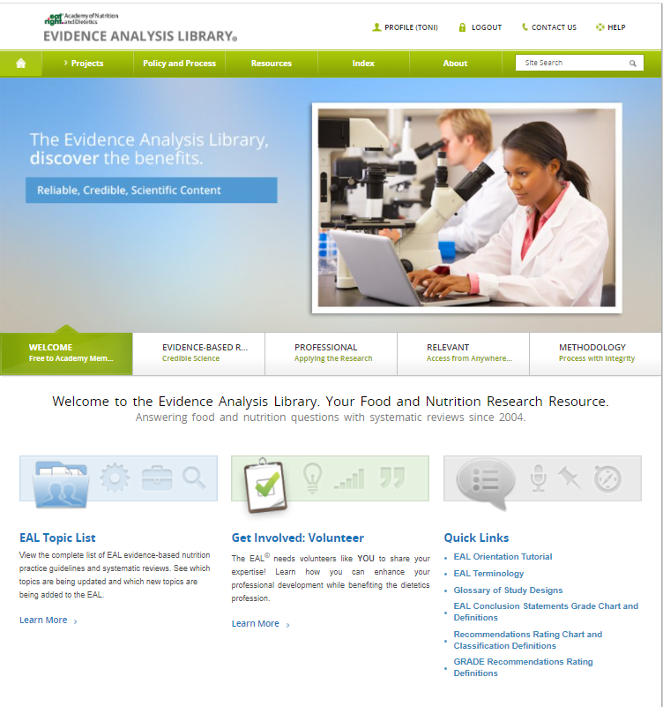
Questions?
Visit the Evidence Analysis Library at www.andeal.org or email eal@eatright.org.
© 2024 Evidence Analysis Library®

