Slide 1


Academy of Nutrition and Dietetics
Evidence Analysis Library®
www.andeal.org
Very Low Birthweight Preterm Infant Enteral Nutrition 2020
Evidence-Based Nutrition Practice Guidelines
Executive Summary of Recommendations
© 2020 Evidence Analysis Library®

Slide 2
Academy Definition
What is Evidence-based Dietetics Practice?
“Evidence-Based Dietetics Practice is the use of systematically reviewed scientific evidence in making food and nutrition practice decisions by integrating best available evidence with professional expertise and client values to improve outcomes.”
ADA Scope of Dietetics Practice Framework: Approved by ADA House of Delegates
© 2020 Evidence Analysis Library®

Slide 3
Overall Guideline Objective
To provide enteral nutrition recommendations for health care practitioners working with VLBW preterm infants and their families that address the controversies and gaps in nutrition care that will promote health, growth and development; and address health consequences associated with preterm birth.
© 2020 Evidence Analysis Library®

Slide 4
Specific Objectives
To provide evidence-based, specific, action statements regarding recommended enteral nutrition for VLBW preterm infants.
To guide enteral nutrition recommendations for VLBW preterm infants that allows for patient-centered care, consideration of family preferences, and short- and long-term health, growth and development.
© 2020 Evidence Analysis Library®

Slide 5
Target Population
Very low birthweight preterm infants
Target Population Description
Preterm infants less than or equal to 1,500g in developed nations.
© 2020 Evidence Analysis Library®

Slide 6
Statement of Intent
Evidence-based nutrition practice guidelines are developed to help dietetic practitioners, patients and consumers make shared decisions about health care choices in specific clinical circumstances. If properly developed, communicated and implemented, guidelines can improve care.
© 2020 Evidence Analysis Library®

Slide 7
Disclaimer
While Academy evidence-based nutrition practice guidelines represent a statement of best practice based on the latest available evidence at the time of publishing, they are not intended to overrule professional judgment. Rather, they may be viewed as a relative constraint on individual clinician discretion in a particular clinical circumstance. The independent skill and judgment of the health care provider must always dictate treatment decisions. These nutrition practice guidelines are provided with the express understanding that they do not establish or specify particular standards of care, whether legal, medical or other.
© 2020 Evidence Analysis Library®

Slide 8
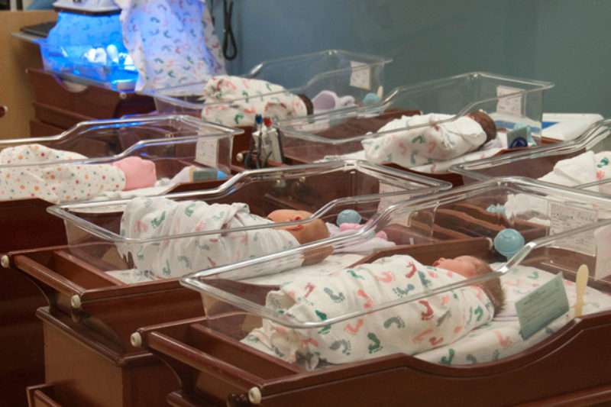
Preterm Infant VLBW Enteral Nutrition 2020
Executive Summary of Recommendations
© 2020 Evidence Analysis Library®

Slide 9
Guideline Rating
Each Recommendation is Rated:
  Strong,
  Fair,
  Weak,
  Consensus, or
  Insufficient Evidence
Each Recommendation Statement is:
  Conditional or
  Imperative
© 2020 Evidence Analysis Library®

Slide 10
Guideline Rating Chart (1 of 2)
Statement Rating | Definition | Implication for Practice
Strong | A Strong recommendation means that the workgroup believes that the benefits of the recommended approach clearly exceed the harms (or that the harms clearly exceed the benefits in the case of a strong negative recommendation), and that the quality of the supporting evidence is excellent/good (grade I or II).* In some clearly identified circumstances, strong recommendations may be made based on lesser evidence when high-quality evidence is impossible to obtain and the anticipated benefits strongly outweigh the harms. | Practitioners should follow a Strong recommendation unless a clear and compelling rationale for an alternative approach is present.
Fair | A Fair recommendation means that the workgroup believes that the benefits exceed the harms (or that the harms clearly exceed the benefits in the case of a negative recommendation), but the quality of evidence is not as strong (grade II or III).* In some clearly identified circumstances, recommendations may be made based on lesser evidence when high-quality evidence is impossible to obtain and the anticipated benefits outweigh the harms. | Practitioners should generally follow a Fair recommendation but remain alert to new information and be sensitive to patient preferences.
Weak | A Weak recommendation means that the quality of evidence that exists is suspect or that well-done studies (grade I, II, or III)* show little clear advantage to one approach versus another. | Practitioners should be cautious in deciding whether to follow a recommendation classified as Weak, and should exercise judgment and be alert to emerging publications that report evidence. Patient preference should have a substantial influencing role.
© 2020 Evidence Analysis Library®
Notes:
Strong: Practitioners should follow a Strong recommendation unless a clear and compelling rationale for an alternative approach is present.
Insufficient Evidence: Practitioners should feel little constraint in deciding whether to follow a recommendation labeled as Insufficient Evidence and should exercise judgment and be alert to emerging publications that report evidence that clarifies the balance of benefit versus harm. Patient preference should have a substantial influencing role.

Slide 11
Guideline Rating Chart (2 of 2)
Statement Rating | Definition | Implication for Practice
Consensus | A Consensus recommendation means that Expert opinion (grade IV) supports the guideline recommendation even though the available scientific evidence did not present consistent results, or controlled trials were lacking. | Practitioners should be flexible in deciding whether to follow a recommendation classified as Consensus, although they may set boundaries on alternatives. Patient preference should have a substantial influencing role.
Insufficient Evidence | An Insufficient Evidence recommendation means that there is both a lack of pertinent evidence (grade V)* and/or an unclear balance between benefits and harms. | Practitioners should feel little constraint in deciding whether to follow a recommendation labeled as Insufficient Evidence and should exercise judgment and be alert to emerging publications that report evidence that clarifies the balance of benefit versus harm. Patient preference should have a substantial influencing role.
© 2020 Evidence Analysis Library®
Notes:
Strong: Practitioners should follow a Strong recommendation unless a clear and compelling rationale for an alternative approach is present.
Insufficient Evidence: Practitioners should feel little constraint in deciding whether to follow a recommendation labeled as Insufficient Evidence and should exercise judgment and be alert to emerging publications that report evidence that clarifies the balance of benefit versus harm. Patient preference should have a substantial influencing role.

Slide 12
Conditional / Imperative
Conditional statements clearly define a specific situation and contain conditional text that would limit their applicability to specified circumstances, or to a sub-population group. More specifically, a conditional recommendation can be stated in if/then terminology.
  e.g., If an individual does not eat food sources of omega-3 fatty acids, then 1g of EPA and DHA omega-3 fatty acid supplements may be recommended for secondary prevention.
Imperative recommendations are broadly applicable to the target population and are stated as “require,” or “must,” or “should achieve certain goals.”
  e.g., Portion control should be included as part of a comprehensive weight management program. Portion control at meals and snacks results in reduced energy intake and weight loss.
© 2020 Evidence Analysis Library®

Slide 13
VLBW Preterm Infant Guideline Topics
Nutrition Intervention
  Protein Amount
  Type of Fat
  Human Milk Fortification
  Formula Enrichment
  Mother’s Milk
  Human Milk (Mother’s and Donor)
  Mother’s Milk Supplementation
© 2020 Evidence Analysis Library®

Slide 14

Recommendations:
a series of guiding statements that propose a
course of action
for practitioners
© 2020 Evidence Analysis Library®

Slide 15

Nutrition Intervention
© 2020 Evidence Analysis Library®

Slide 16
VLBW: Protein Amount
Healthcare practitioners should provide 3.5g to 4.0g of protein per kg bodyweight via enteral nutrition to very low birthweight (less than or equal to 1,500g) preterm infants. Protein intake at 3.5g to 4.0g per kg bodyweight supports superior growth and protein accretion compared to protein intake of less than 3.5g per kg bodyweight.
Fair
Imperative
© 2020 Evidence Analysis Library®

Slide 17
VLBW: Type of Fat
Health care practitioners should not routinely supplement additional enteral long chain fatty acids [docosahexaenoic acid (DHA), eicosapantaenoic acid (EPA), and arachidonic acid (AA]) for very low birthweight (less than or equal to 1,500g at birth) preterm infants. If health care practitioners choose to supplement additional omega-3, then AA should also be provided. Current evidence does not suggest consistent benefits with enteral long chain fatty acid supplementation.
Fair
Imperative
© 2020 Evidence Analysis Library®

Slide 18
VLBW: Human Milk Fortification
Healthcare practitioners should fortify human milk fed to very low birth weight preterm infants because fortification increases weight gain and head circumference growth compared to human milk alone.
Weak
Imperative
© 2020 Evidence Analysis Library®

Slide 19
VLBW: Formula Enrichment
When human milk is not available, healthcare practitioners should provide very low birthweight (less than or equal to 1,500g) preterm infants with preterm infant formulas that provide higher nutrient density than standard infant formula. Nutrient-dense preterm formulas appear to more closely match the nutritional needs of very low birthweight preterm infants and long clinical experience with preterm formulas suggests that they support good growth, and both functional, and biochemical measures of nutritional adequacy.
Consensus
Conditional
© 2020 Evidence Analysis Library®

Slide 20
VLBW: Mother’s Milk
Health care practitioners should provide fortified mother's milk, when available, to VLBW (less than or equal to 1,500g) preterm infants. Mother's own milk intake is associated with lower odds of retinopathy of prematurity when compared to exclusive formula, and there is evidence of a negative dose-response relationship with sepsis and a positive dose-response relationship with Bailey development scores.
Fair
Conditional
© 2020 Evidence Analysis Library®

Slide 21
VLBW: Human Milk (Mother’s and Donor)
Health care practitioners should provide fortified human milk regardless of source (mother's or donor) to very low birth weight (less than or equal to 1,500g) infants when available. Growth should be monitored by practitioners and the nutrition care plan should be adjusted as appropriate.
Weak
Conditional
© 2020 Evidence Analysis Library®

Slide 22
VLBW: Mother’s Milk Supplementation
When quantity of mothers’ milk is insufficient, health care practitioners should supplement VLBW (less than or equal to 1,500g) preterm infants with donor milk during the time that the infant is at high risk for necrotizing enterocolitis (NEC). VLBW preterm infants fed mother's own milk supplemented with donor milk had a lower risk of NEC compared to those fed mother's own milk supplemented with formula.
Fair
Conditional
© 2020 Evidence Analysis Library®

Slide 23
Citation
Evidence-based Nutrition Practice Guideline on VLBW Preterm Infants published at www.andeal.org/pti and copyrighted by the Academy of Nutrition and Dietetics. Accessed on August 27, 2020.
© 2020 Evidence Analysis Library®

Slide 24
No Implied Endorsement
No endorsement by the Academy of Nutrition and Dietetics of any brand-name product or service is intended or should be inferred from a Guideline or from any of its components (including Question, Evidence Summary, Conclusion Statement, Conclusion Statement Grade, Recommendation or Recommendation Rating).
  Evidence-based Nutrition Practice Guidelines are intended to serve as a synthesis of the best evidence available to inform registered dietitians as they individualize nutrition care for their clients. Guidelines are provided with the express understanding that they do not establish or specify particular standards of care, whether legal, medical or other.
  Evidence-based Nutrition Practice Guidelines are intended to summarize best available research as a decision tool for Academy members.
© 2017 Evidence Analysis Library®

Slide 25

For additional information:
www.andeal.org
The EAL is free for members of the Academy of Nutrition and Dietetics. Individual and group subscriptions are available from the EAL. Email us at:
eal@eatright.org
© 2020 Evidence Analysis Library®

